Slide 1
Domain adaptation for classifying disaster-related Twitter data
Department of Computer Science
College of Engineering
Presenter: Oleksandra Sopova
Major Professor: Doina Caragea
GRAD Forum
March 30, 2017

Slide 2
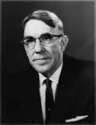
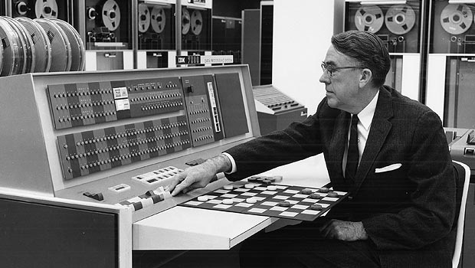
What is Machine Learning?
Arthur Samuel
(1901-1990)
– a pioneer of artificial intelligence research
Arthur Samuel’s Checkers program is considered a milestone for artificial intelligence, and offered the public in the early 1960s an example of the capabilities of an electronic computer.

Slide 3

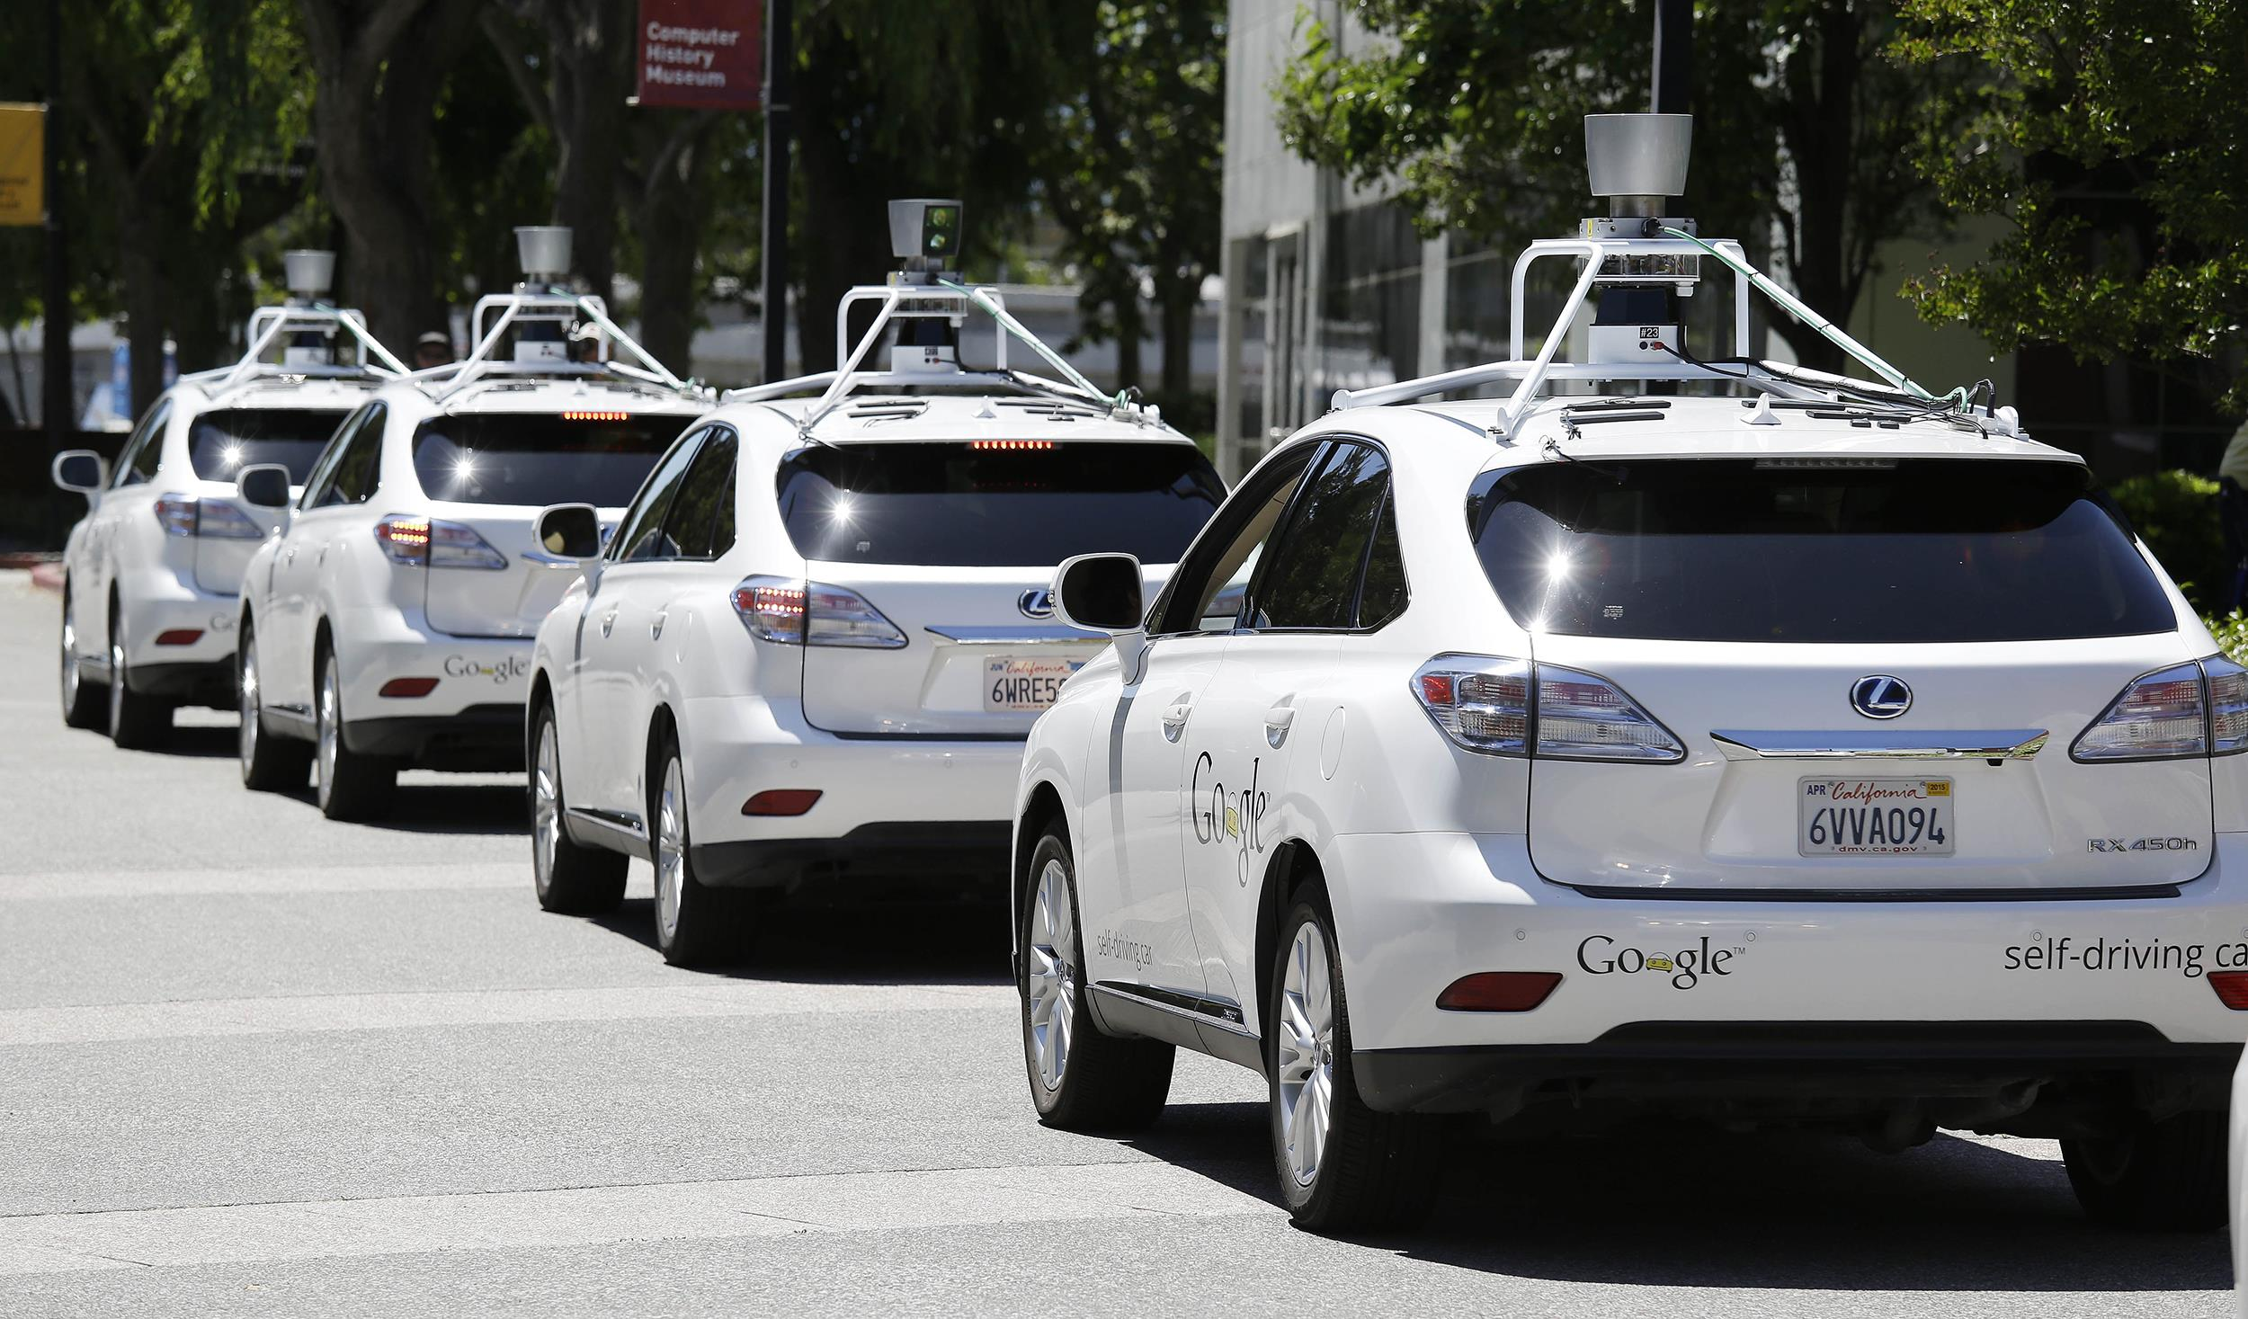

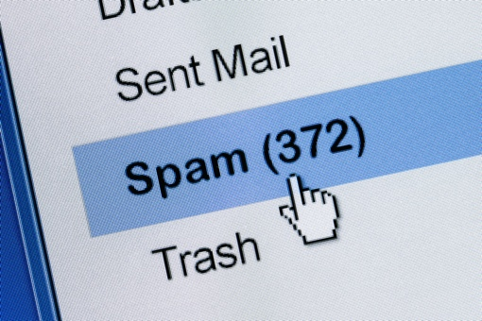

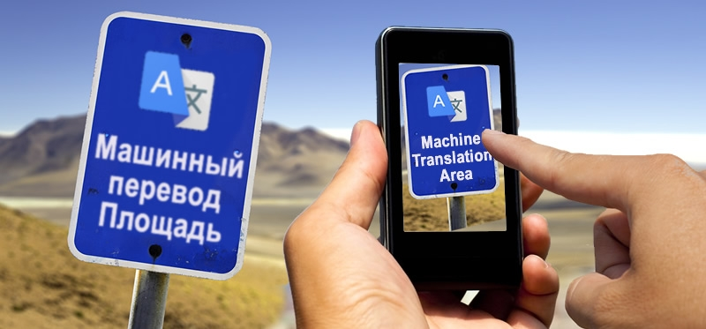
What is Machine Learning?
Examples of machine learning tasks may include:
Recommender systems
Self-driving cars
Image search
[Link]
[Link]
Machine Translation
Spam Filtering
Text Recognition
[Link]
[Link]
[Link]

Slide 4
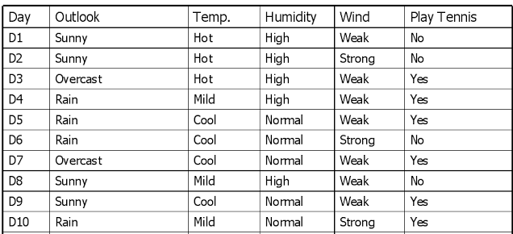

Terminology
Instances (examples, observations)
[Link]
Could you predict the values of “Plat Tennis”?
?
?
?
[Link]

Slide 5
Terminology
Label (class)
Instances (examples, observations)
[Link]
Could you predict the values of “Plat Tennis”?
?
?
?
[Link]

Slide 6
Terminology
Features
Label (class)
Instances (examples, observations)
[Link]
Could you predict the values of “Plat Tennis”?
?
?
?
[Link]

Slide 7
Terminology
Supervised Machine Learning
– learning from labeled data
Unsupervised Machine Learning
– learning from unlabeled data

Slide 8
Supervised Learning Model Workflow
Step 1: Collecting, cleaning, preprocessing of data (training data)
Feature Extraction
Preprocessed Data, Labels
Raw Data, Labels

Slide 9
Supervised Learning Model Workflow
Step 2: Training a machine learning model
Preprocessed Data, Labels
Machine Learning Algorithm
Feed the data
Trained Machine Learning Model

Slide 10
Supervised Learning Model Workflow
Step 2: Predicting output on unseen data (testing data)
Trained Machine Learning Model
Preprocessed Unseen Data
Feed the data
Output
(i.e. predicted labels)

Slide 11
Supervised Machine Learning

Slide 12
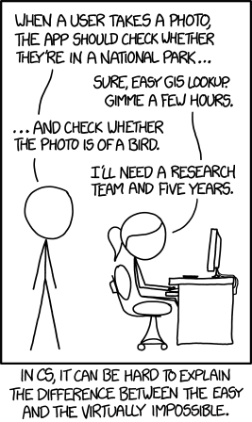
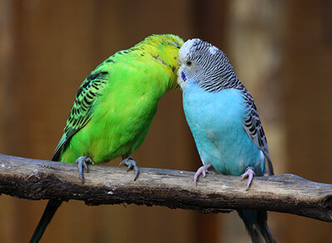
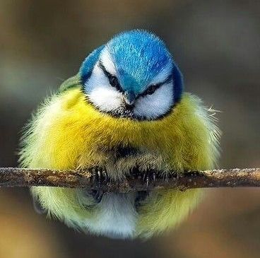
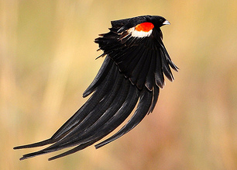
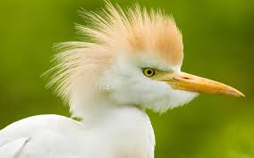
Motivation for Machine Learning
Some tasks are difficult to define algorithmically
Example: is there a bird in a given picture?

Slide 13



Motivation for Machine Learning
Human language is ambiguous
Could you come up with a universal rule to tell which tweets are about natural disasters?

Slide 14
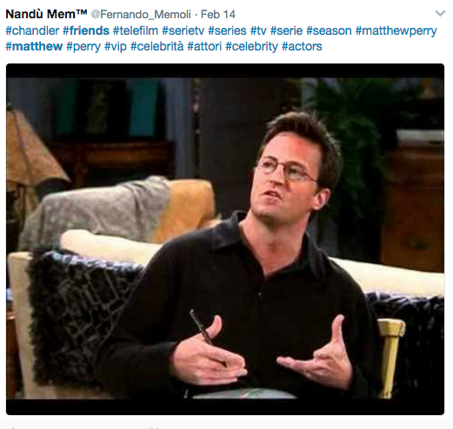
Motivation for Machine Learning
Human language is ambiguous
Using hashtags?

Slide 15
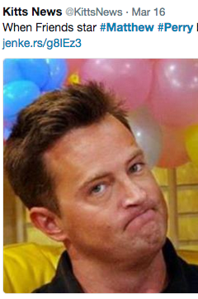
Motivation for Machine Learning
Human language is ambiguous
Using hashtags?
– not too reliable:

Slide 16
Background on Disaster Management

Slide 17
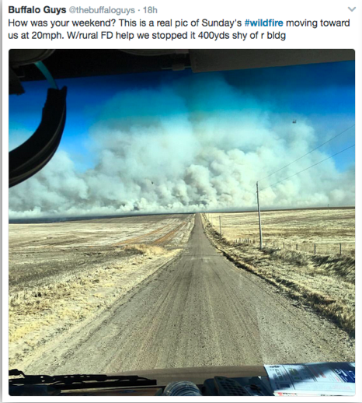
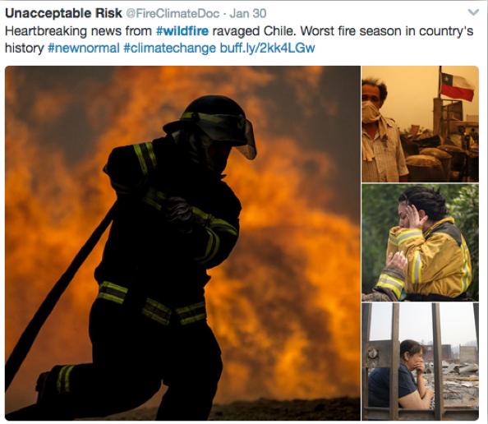
Background on Disaster Management

Slide 18
Domain Adaptation Terminology

Slide 19
Motivation for Domain Adaptation

Slide 20
Problem Definition

Slide 21
Data Description

Slide 22
Data Preprocessing

Slide 23
Single-source Domain Adaptation Approach

Slide 24
Correlation Alignment Algorithm

Slide 25
Feature Selection

Slide 26
Naive Bayes Classifier

Slide 27
Experiments

Slide 28
Results

Slide 29
Terminology
[Link]

